Slide 1
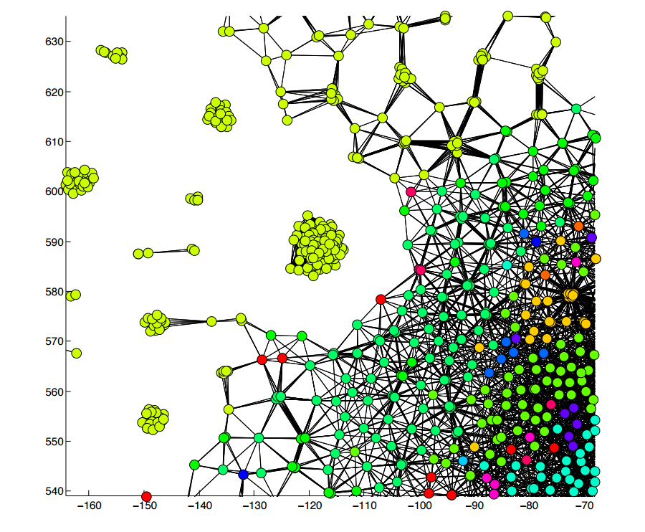

TreeScaper: Using Networks to Explore, Quantify, and Summarize Phylogenetic Tree Space
Jeremy Ash, Wen Huang, Guifang Zhou, Melissa Marchand, Paul Van Dooren, James Wilgenbusch, Kyle Gallivan, Jeremy M. Brown

Slide 2



















The Team
Kyle Gallivan
Wen Huang
Paul Van Dooren
Guifang Zhou
Melissa Marchand
Jeremy Brown
Jeremy Ash
David Morris
Jim Wilgenbusch

Slide 3
Part 1 Non-Linear Dimensionality Reduction in TreeScaper

Slide 4





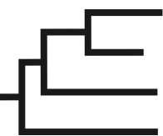
Tree Sets

Slide 5
Summarizing Tree Sets
Consensus trees
MASTs
Clustering
NLDR
0.9
0.7

Slide 6
Summarizing Tree Sets
Consensus trees
Agreement subtrees
Clustering
NLDR
Prune

Slide 7
Summarizing Tree Sets
Consensus trees
Agreement subtrees
Clustering
NLDR

Slide 8
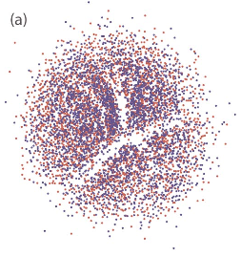
Summarizing Tree Sets
Consensus trees
Agreement subtrees
Clustering
Dimensionality Reduction

Slide 9
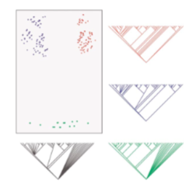
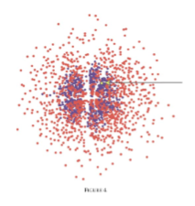
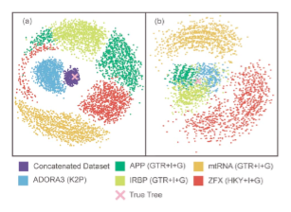
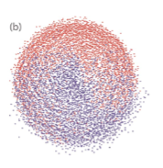
Hillis, Heath, and St. John, 2005. Analysis and visualization of tree space. Systematic Biology 54(3): 471-482.
Dimensionality Reduction in Phylogenetics
Explore tree islands
Compare bootstrap and Bayesian results
Compare trees obtained from different genes
Compare independent runs in a Bayesian analysis
Notes:
Tree islands: clusters of topologies that are near-optimal phylogenetic solutions for a given dataset.
Figure 7b shows the results of a similar analysis, but using weighted Robinson-Foulds distances to compare the trees, and in this case the sampled space of the two runs is clearly distinguishable. We interpret this result to mean that there is a greater degree of branch-length similarity within independent runs than between runs, suggest- ing that the chains have either not reached stationar- ity with respect to branch lengths

Slide 10
Our Contribution
Does the Nonlinear Dimensionality Reduction (NLDR) method matter?
How to measure the quality of the NLDR visualization?
What is the intrinsic dimensionality of the data?
Is 3D needed to fit tree-to-tree distances?
Develop software for exploring large sets of trees.
Written in C++ with efficient computational methods
Notes:
Mention that Math PhD students at FSU with expertise in numerical linear algebra
There is TreeSet Viz in Mesquite

Slide 11

Phylogenetic Bipartitions
Bipartition:
A division of the elements of the set into two groups
In this case:
(6,7,8)|(the rest)
Notes:
A branch can be viewed as a partition, because it separates the taxa into two groups.

Slide 12
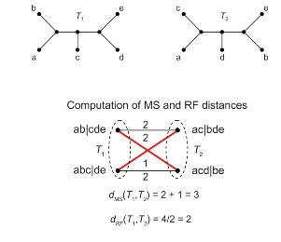
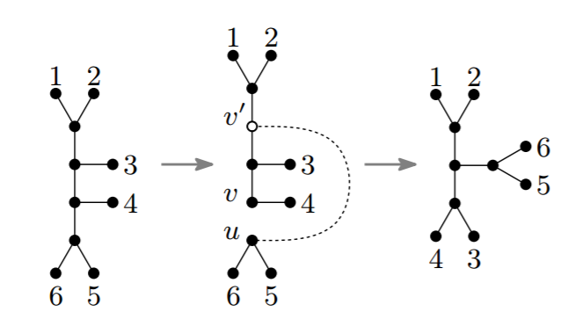
Plot Trees as a “Phylogenetic Landscape”
Generate a matrix of tree-to-tree distances
Robinson Foulds (RF)
weighted or unweighted
Matching
Subtree Prune Regraft (SPR)
RF and Matching
Bogdanowicz et al. 2012.
SPR
Whidden and Matsen 2015.
Notes:
RF Distance
-Number of splits that differ between two topologies, divided by 2.
-Only non-trivial bipartitions
-Moving one taxa to across the tree results in a near maximal RF value, when really only requires one SPR
Matching Distance
-The total number of taxa rearrangements that convert bipartitions of one topology to their most similar counterparts in another topology.
-Match one bipartition in one tree with one bipartition in another
-complete bipartite matching (one to one mapping)
-extend number of bipartitions with dummy bipartitions if number is unequal
-find matching with minimal cost (sum of edge weights).
-edges weighted by the number of taxa that need to be rearranged to convert one bipartition to another
SPR distance – the minimal SPR path (number of SPR moves to convert one tree into another)
- rooted version of SPR distance can be computed relatively efficiently between rooted trees using fixedparameter-tractable maximum agreement forest (MAF) algorithms, no MAF formulation is known for the unrooted case
- Whidden

Slide 13
Plot Trees as a “Phylogenetic Landscape”
Use a dimensionality reduction method to project tree-to-tree distances into a 2D space

Slide 14
Principle Components Analysis
Finds best representation of data on a lower dimensional linear surface
Best in terms of sum of squared residuals
Percent of variability of the data explained on the PC axes provide a measure of quality of low dimensional representation
From “An Introduction to Statistical Learning” by Hastie et al.
Notes:
Poll people on their knowledge of PCA
Minimizing the sum of squared residuals
Trees are not in Euclidean space, so cannot think of dimensionality reduction as minding the linear surface closest to points in Euclidean space

Slide 15
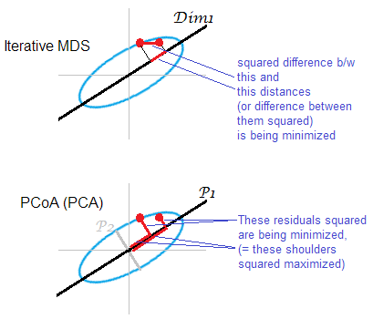
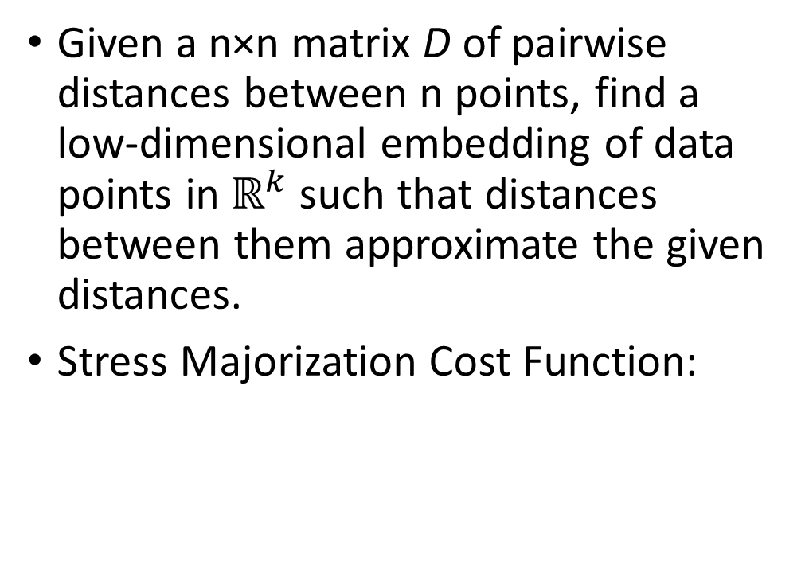
Multidimensional Scaling
Given a n×n matrix D of pairwise distances between n points, find a low-dimensional embedding of data points in $ℝ^{k}$ such that distances between them approximate the given distances.
Stress Majorization Cost Function:
MDS
PCA
Notes:
PCA: Minimizes the residual sum of squares
Stress Majorization: The solution is not given by any closed formula, and must be computed by a optimization algorithm (many of which are implemented in TreeScaper). Stress majorization is an example of non-linear dimensionality reduction.

Slide 16
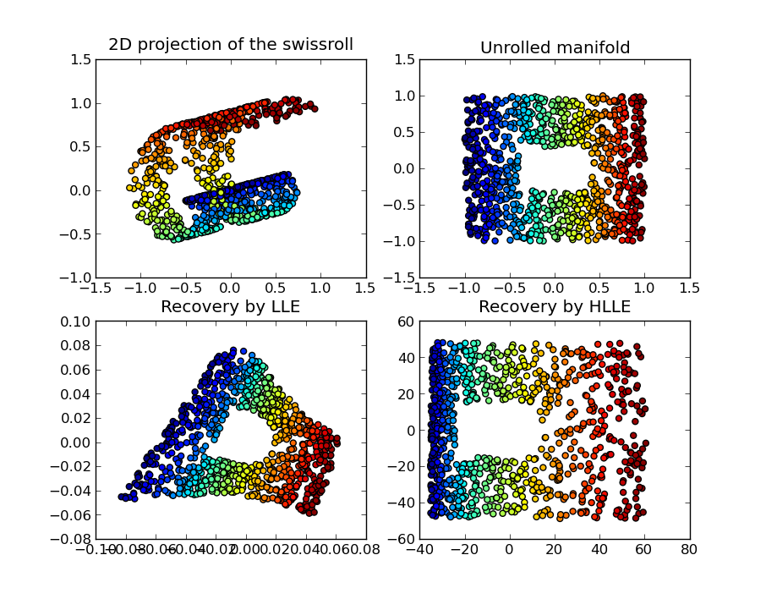
Non-Linear Dimensionality Reduction
Methods assume the data lie close to an intrinsically low-dimensional non-linear surface embedded in a high-dimensional space.
NLDR methods can be thought of as “flattening” the surface
Reduces the data to a set of low-dimensional coordinates that represent their relative positions in the surface.
Figure By Olivier Grisel
Notes:
Given: Low-dim. surface embedded nonlinearly in high-dim. space Such a structure is called a Manifold

Slide 17
TreeScaper NLDR
Cost Functions
Sammon’s Nonlinear Mapping
More emphasis is put on preserving smaller pairwise distances.

Slide 18
TreeScaper NLDR
Cost Functions
Optimization Algorithms
Sammon’s Nonlinear Mapping
Kruskal-1 Stress
Normalized Stress
Curvilinear Components Analysis (CCA)
Linear Iteration
Majorization
Gauss-Seidel
Stochastic Gradient Descent

Slide 19
Example Analysis
Generate a large set of ML bootstrap trees
For 15 genes a 3 mtDNA genome alignments (Salamanders, Mammals, and Fishes)
Evaluate trees with different NLDR Methods

Slide 20
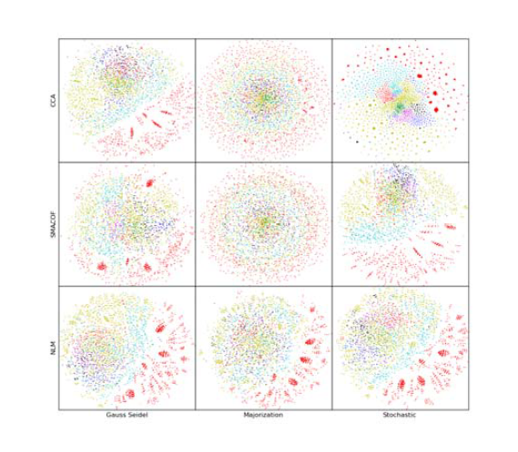
Projections in 2D Bootstrap Trees from 15 mtDNA Genes
Figure by Wen Huang
Notes:
Weighted RF-Distance used. There are issues with the weighted RF (moving one taxa a large distance across the tree dramatically increases the RF distance, when intuitively this should have a small affect on the tree-to-tree distance as this is only one SPR move)

Slide 21
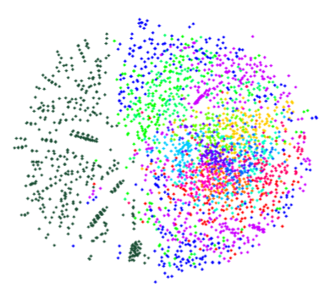
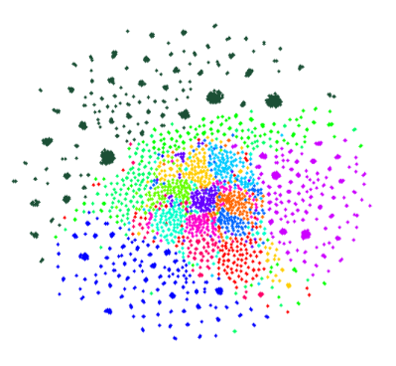
Projections in 2D Bootstrap Trees from 15 mtDNA Genes
Kruskal-1 & Linear Iteration
CCA & Stochastic Gradient
Colors = trees from different genes
Figure by Wen Huang
Notes:
Kruskal-1 NLDR method and linear iteration is what tree set viz uses.
-Stochastic gradient descent has the best performance out of the optimization algorithms. Our research has shown that CCA is often the best performing NLDR method for visualizing structure of interest in tree space, so the default methods are stochastic gradient descent and CCA.

Slide 22
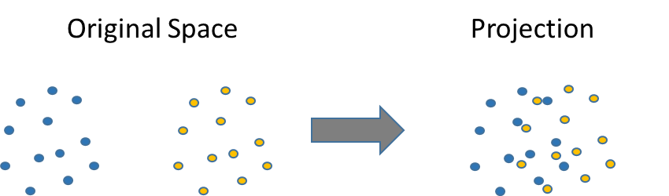
Measures of NLDR Quality
Trustworthiness measures to what extent the k closest neighbors of each point in the original space are close by in the display.
Continuity reverses roles of display and original space. Measures to what extent the k closest neighbors of each point in the original space are close by in the display.
Both measures are between 0 and 1
Notes:
Continuity measures how many of the set of k closest neighbors of each sample in the original space are close by in the display (really are close and are close in display). Discontinuity caused by flattening globe (next slide).
Trustworthiness reverses roles of display and orginal space. measure of how many of k closest neighbors of each sample in the display are close by in the original space (close in display and really are close).
For each point, rank all other points in order from closest to farthest from that point. For some k, a point that is the k nearest neighbor in the original space is not the k nearest neighbor in the display, then take the difference of the rank of that data point and k.
-The second decision that needs to be made is how to measure similarity preservation within the neighborhood of proximate samples. In principle, preservation of all distances could be directly measured, but we discounted this possibility because it would bias the study in favor of MDS methods that try to directly preserve all distances. We considered it enough that distances were preserved in the within a neighborhood of each sample.
-More formally, let N be the number of data samples and r(x_{i}, x_{j}) be the rank of the data sample x_{j} in the ordering according to distance from x_{i} in the original data space. Denote by U_{k}(x_{i}) the set of those data samples that are in the neighborhood of sample x_{i} in the visualization display but not in the original data space. Our measure of trustworthiness of the visualization, M₁, is defined by

Slide 23
Both Measures Are Useful
Original Space
Projection
High Trustworthiness
Low Continuity
Low Trustworthiness
High Continuity
High Trustworthiness
High Continuity

Slide 24
Measures of NLDR Quality
CCA & Stochastic Gradient
Figure by Wen Huang
Notes:
Continuity measures how many of the set of k closest neighbors of each sample in the original space are close by in the display (really are close and are close in display). Discontinuity caused by flattening globe (next slide).
Trustworthiness reverses roles of display and orginal space. measure of how many of k closest neighbors of each sample in the display are close by in the original space (close in display and really are close).
For each point, rank all other points in order from closest to farthest from that point. For some k, a point that is the k nearest neighbor in the original space is not the k nearest neighbor in the display, then take the difference of the rank of that data point and k.
-The second decision that needs to be made is how to measure similarity preservation within the neighborhood of proximate samples. In principle, preservation of all distances could be directly measured, but we discounted this possibility because it would bias the study in favor of MDS methods that try to directly preserve all distances. We considered it enough that distances were preserved in the within a neighborhood of each sample.
-More formally, let N be the number of data samples and r(x_{i}, x_{j}) be the rank of the data sample x_{j} in the ordering according to distance from x_{i} in the original data space. Denote by U_{k}(x_{i}) the set of those data samples that are in the neighborhood of sample x_{i} in the visualization display but not in the original data space. Our measure of trustworthiness of the visualization, M₁, is defined by

Slide 25

Discontinuity in NLDR:
Flattening of a Globe

Slide 26
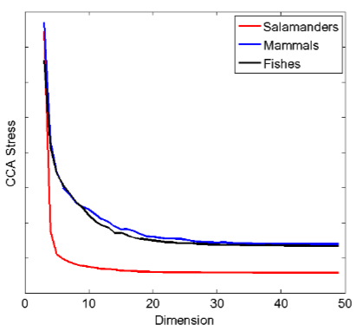
Is 3D Needed?
YES
Intrinsic dimensionality estimators
Nearest Neighbor estimator
Correlation Dimension
Maximum Likelihood estimator
Visual inspection of stress versus dimension
3 to 15 dimensions are needed to fit tree-to-tree distances

Slide 27
Intrinsic Dimensionality
CCA & Stochastic Gradient
Notes:
Maximum likelihood estimator of the dimensionality.
The location of each data point is assumed to have a probability distribution that has a parameter that corresponds to the intrinsic dimensionality of the data. The intrinsic dimensionality of the data is estimated using maximum likelihood. The probability distribution is also a function of the k-nearest neighbors considered for each data point, so the dimensionality is estimated over a range of values of k and the average dimension is computed.
The number of points occurring in a sphere in the R^d space is a poisson process. The likelihood function becomes a function of the dimensionality
Need to show how to make these plots and calculate the dimensionality.
1NN in the output?
TO DO: add slide on dimensionality estimation

Slide 28
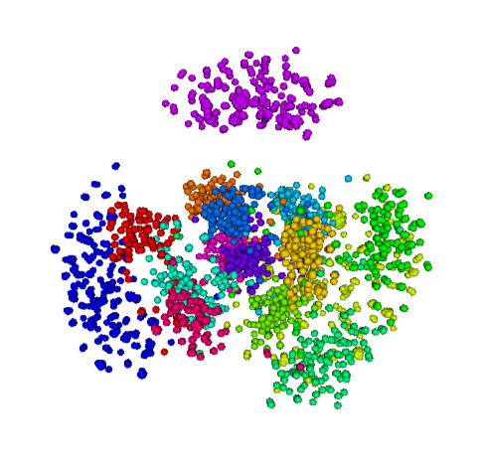
Projection in 3D Bootstrap Trees from 15 mtDNA Genes
Colors = trees from different genes

Slide 29
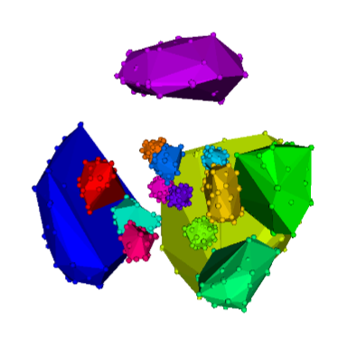
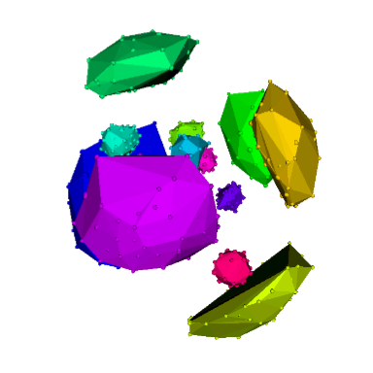
Projections in 3D Bootstrap Trees from 15 mtDNA Genes
Salamanders
Mammals
Colors = trees from different genes
Notes:
-This result likely indicates that the substitution model used to infer trees is failing to adequetly accommodate the underlying process heterogeneity because mtDNA genes are non-recombining and should share a common history

Slide 30
Part 2 Network Community Detection Methods in TreeScaper

Slide 31
Networks
Collaboration network between scientists working in Santa Fe Institute

Slide 32
Biological Networks
Yeast Protein Interaction Network

Slide 33
Social Networks: Community Detection
Author Networks
(by Vincent Traag)
Notes:
In this social network, nodes are Danish authors and edges represent the overall tone of references between authors in a collection of articles.
Network constructed based on 179 Danish authors references to the other authors. References coded as positive, negative or neuatral

Slide 34
Summarizing Tree Sets
Dimensionality Reduction
No objective way to discern distinct groups of trees

Slide 35
A New Approach: Phylogenetic Networks
Represent the tree set as a network
Use community detection methods to identify distinct groups of topologies
Indicative of interesting evolutionary history:
Recombination
Horizontal Gene Transfer
Hybridization
Incomplete Lineage Sorting
May also indicate systematic error

Slide 36
Networks of Trees

Slide 37
Networks of Trees: Community Detection
Community 1
Community 2
Notes:
Community Detection methods maximize the affinity within communities

Slide 38
Networks of Bipartitions
Notes:
Letters indicate taxa. Bars indicate the division between the two groups

Slide 39
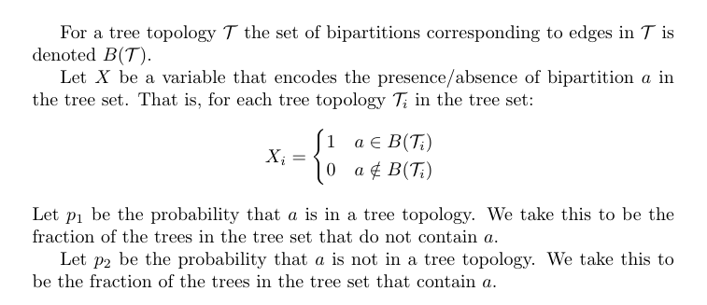
Networks of Bipartitions: Covariances

Slide 40
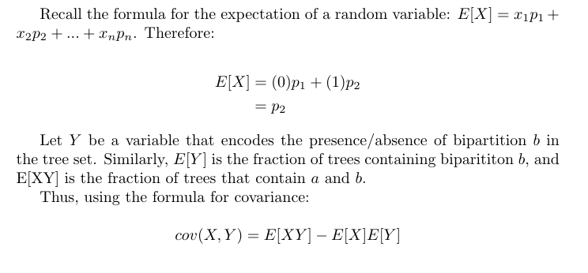
Networks of Bipartitions: Covariances

Slide 41
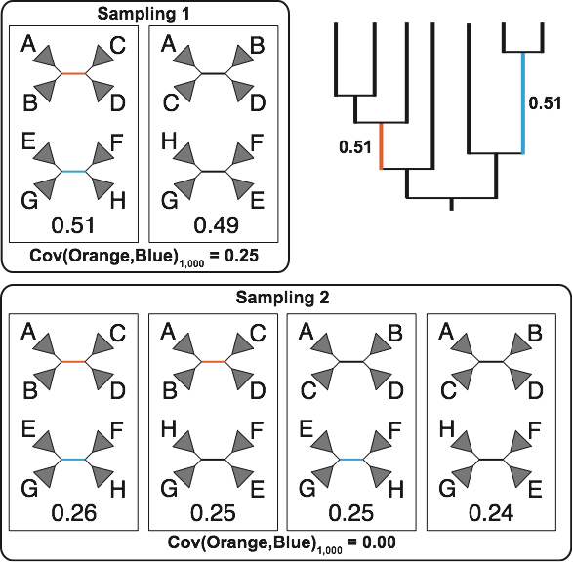
Bipartition Covariances

Slide 42
Bipartition Covariances

Slide 43
Bipartition Covariances

Slide 44
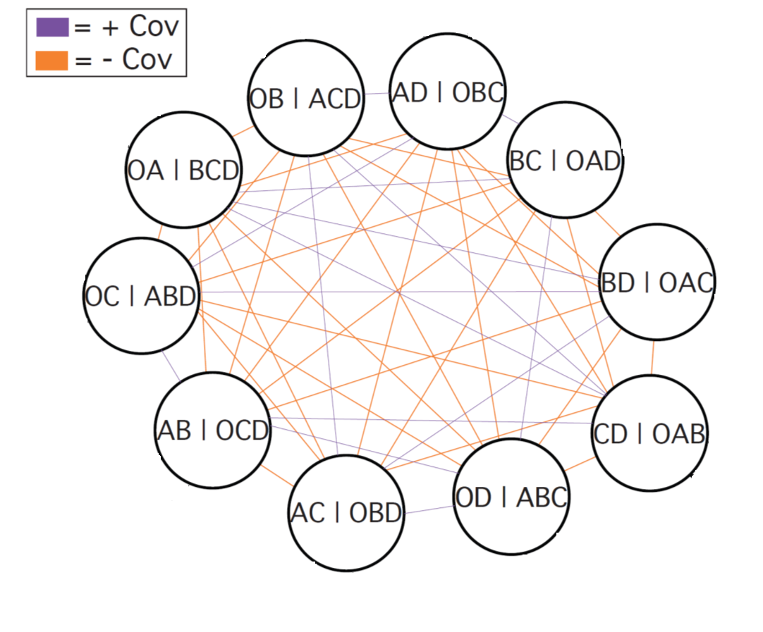
Networks of Bipartitions: Covariance Edge Weights

Slide 45
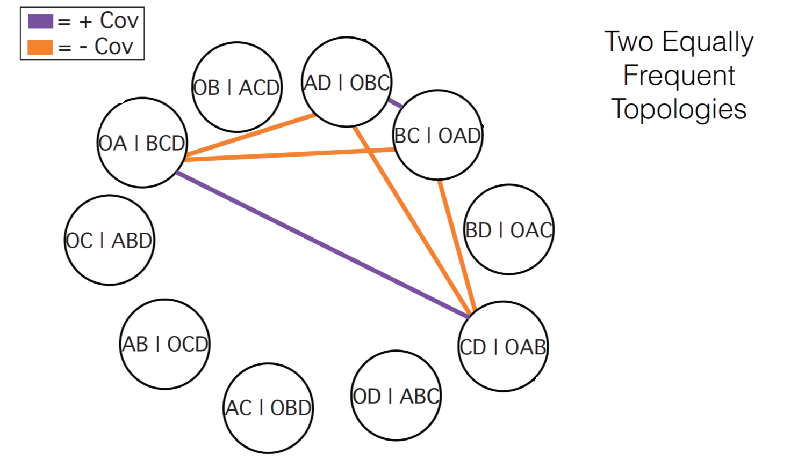
Networks of Bipartitions: Covariance Edge Weights

Slide 46
Networks of Bipartitions: Community Detection
Community 1
Community 2

Slide 47
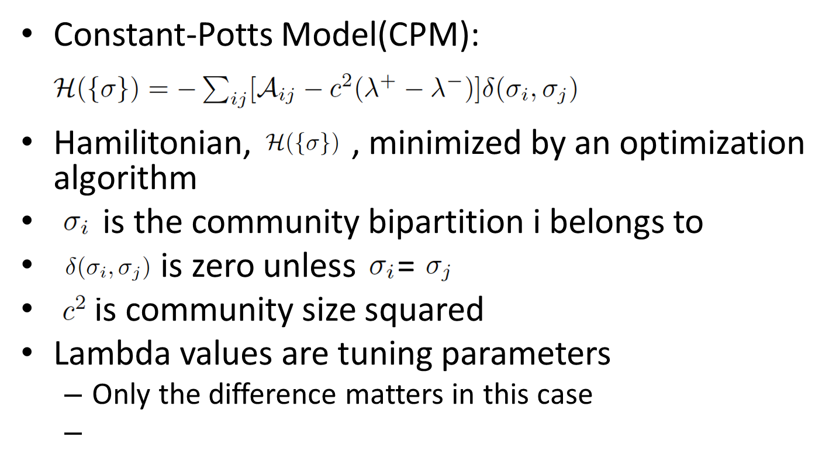
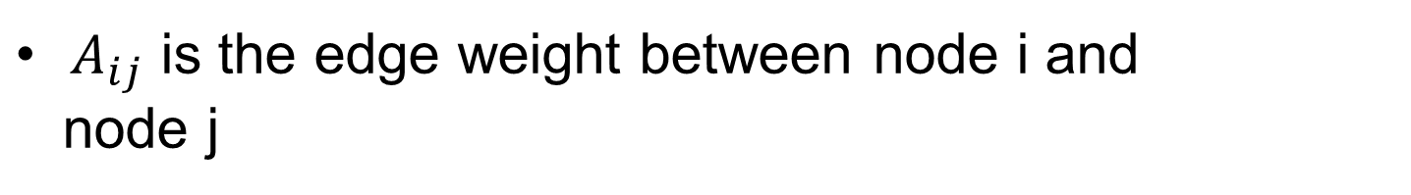
Method for Community Detection
$A_{ij}$ is the edge weight between node i and
node j
Notes:
Optimization algorithm: simulated annealing
Lambda+ and lambda- allow one to vary the reward or penalty for positive or negative edges separately
With other models, replace c^2 with summary measures of the positive and negative edge weights within a community
Break this equation up

Slide 48
Method for Community Detection
λ⁺ is fixed at some value and λ⁻ is varied
The largest range of lambda values that produces a single community structure (and that is between the two extremes) is the most stable community structure in our dataset
Notes:
At very small values of λ⁻ there is a separate community for every bipartition
At very large values of λ⁻ there is one community for all bipartitions
The range of lambda values that produces community structures at these extremes will always be infinite
disregard these community structures

Slide 49
Example: Simulation Experiment

Slide 50
Example: Simulation Experiment

Slide 51
Consensus Tree Contains Misleading Information

Slide 52
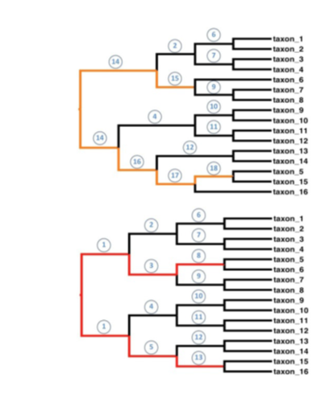
Network of Bipartitions

Slide 53
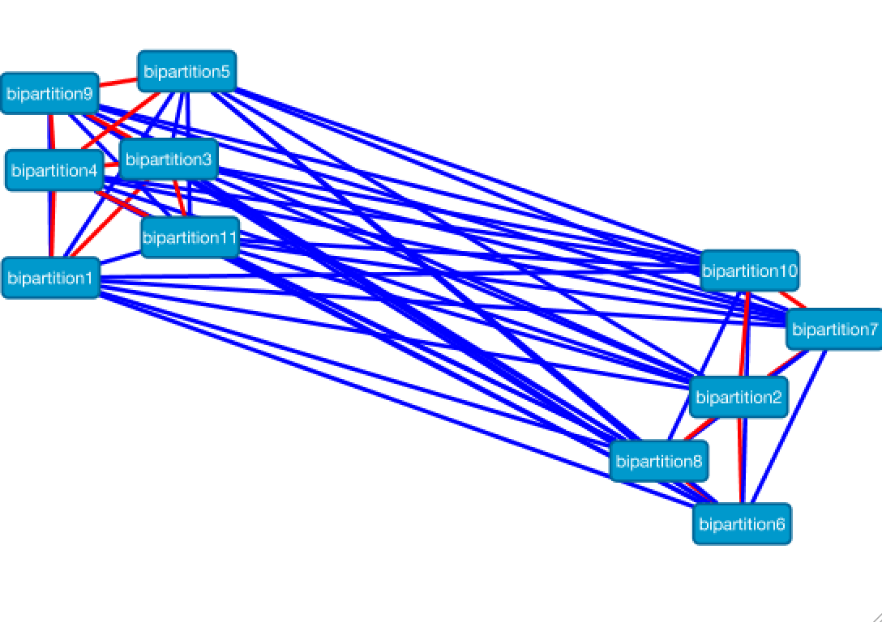
Networks of Bipartitions (in Cytoscape!)

Slide 54
Topology Based Community Detection

Slide 55
Networks Detect Strong Conflict
Notes:
Depending on how many columns are sampled from the two halves of the alignment, taxon 5 can be positioned in the top or bottom clade, or basal to both clades.

Slide 56
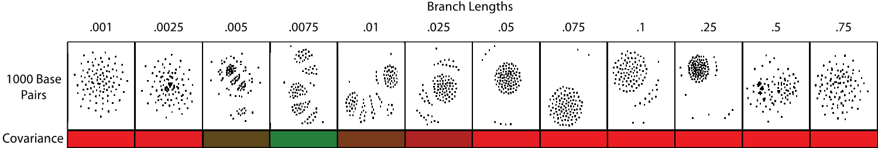
Variation of Branch Length
Notes:
When branch lengths are very long, phylogenetic signal is lost and trees topologies are essentially random. When branch lengths are very short, the only topology present is the tree with taxon 5 at the midpoint.

Slide 57
Example: Empirical Data
Yeast dataset with 5 species, 106 loci
106 gene trees were reconstructed using maximum parsimony

Slide 58
Topology-based Network Analysis
Affinity matrix
Reciprocal of Tree-to-Tree distances
Detect communities
Discovered 11 communities
Consensus trees for each community
Consensus trees
of two largest
communities
recovers 2
candidate species
trees.

Slide 59
Bipartition-based Network Analysis
Covariance matrix based on presence or absence of bipartitions in the gene trees

Slide 60
Other Network Visualizations

Slide 61
Other Network Visualizations

Slide 62


Network Visualizations
Censored
RF distances below 4 removed
COX3
Uncensored
CYTB
ND4
ND1
ND6
ND2

Slide 63
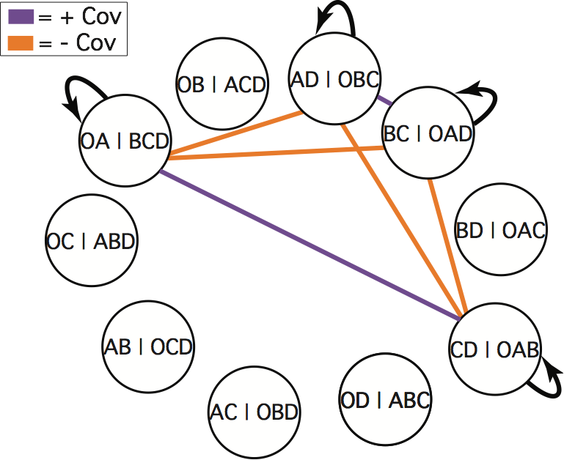
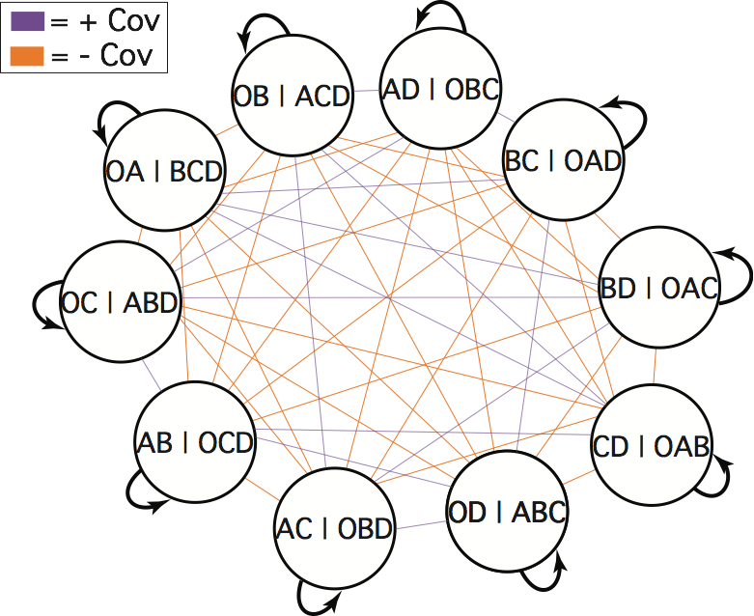
Assessing Model Fit
Using parametric bootstrapping or posterior prediction, we can compare network structures between observed and simulated datasets.
Empirical
Simulated
=

Slide 64
The “Perfect Case”: 50 Trees
Cov(red, black) = (.50) – (.50*.50)
= .25
Cov(red, red) = (1) – (1*1)
= 0

Slide 65
The “Perfect Case”: 50 Trees
Cov(red, orange) = (0) – (.50*.50)
= -.25

Slide 66
The Network

Slide 67
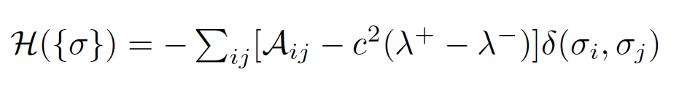
Calculating the Hamiltonian
H_{a} = -(2(10*.25)+(5*.25)) = -6.25
H_{b} = -(2*(10*.25) +(5*.25)) = -6.25
H_{a} + H_{b} = H = -12.5
Hamiltonian minimum
Notes:
5 choose 2 = 10 edges in each community. Multiply by two because the edges are bidirectional, so you count them twice. 5 bipartition variances as well
count the cov(a, b) and cov(b, a) to be separate edges

Slide 68
Calculating the Hamiltonian
H_{a} = -(2*((6*.25) + 4*-.25) + (5*.25)) = -2.25
H_{b} = -(2*((6*.25) + 4*-.25) + (5*.25)) = -2.25
H_{a} + H_{b} = H = -4.5
Hamiltonian not minimized
No closed form solution!
Need optimization algorithm
(simulated annealing)
Notes:
No closed from solution. Simulated annealing used to search over solution path and find a near optimal solution.

Slide 69
Hamiltonian Minimum

Slide 70
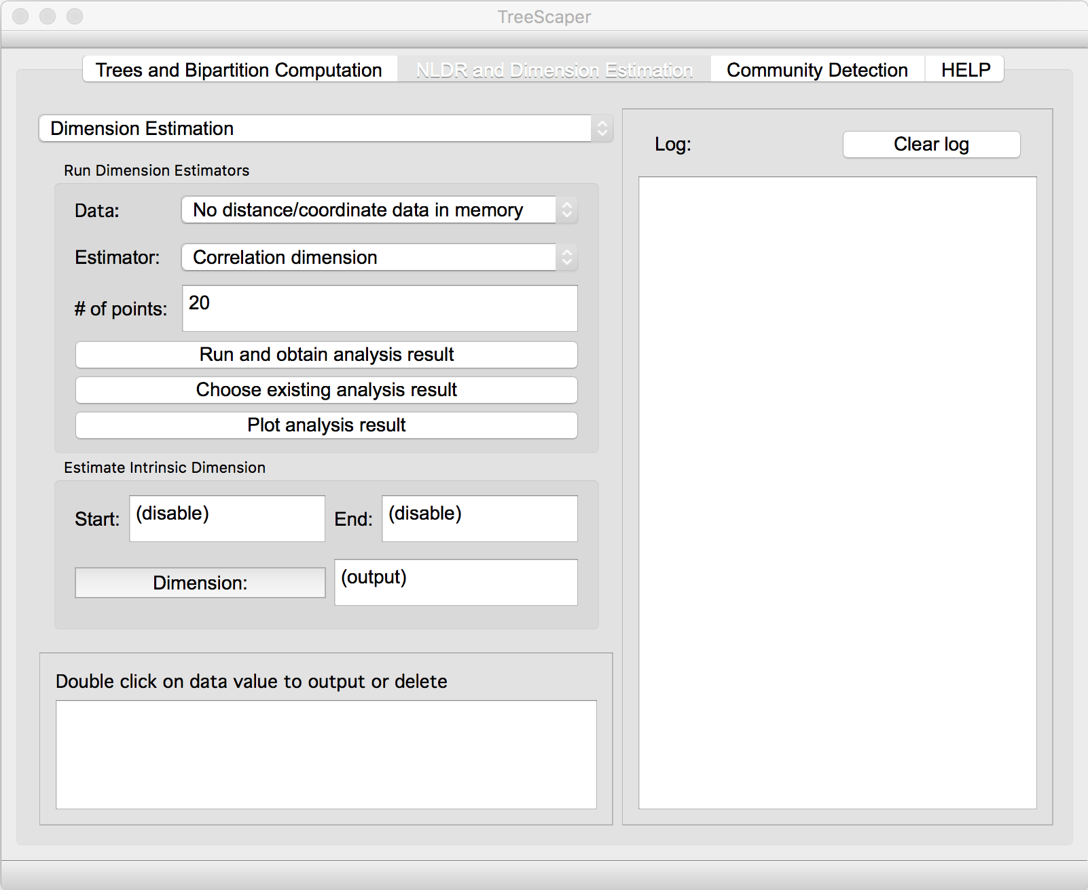
TreeScaper Software
Available on GitHub (developer version)
https://github.com/whuang08/TreeScaper
Available on SourceForge:
https://sourceforge.net/projects/treescaper/
TreeScaper Website:
http://www.math.fsu.edu/~whuang2/Indices/index_TreeScaper.html

Slide 71
Finding the Natural Community Structure
Notes:
λ⁺ is fixed at some value and λ⁻ is varied
At very small values of λ⁻ there is a separate community for every bipartition
At very large values of λ⁻ there is one community for all bipartitions
The range of lambda values that produces community structures at these extremes will always be infinite
disregard these community structures
The largest range of lambda values that produces a single community structure (and that is between the two extremes) is the intrinsic community structure in our dataset

Slide 72
Tree Sets

Slide 73
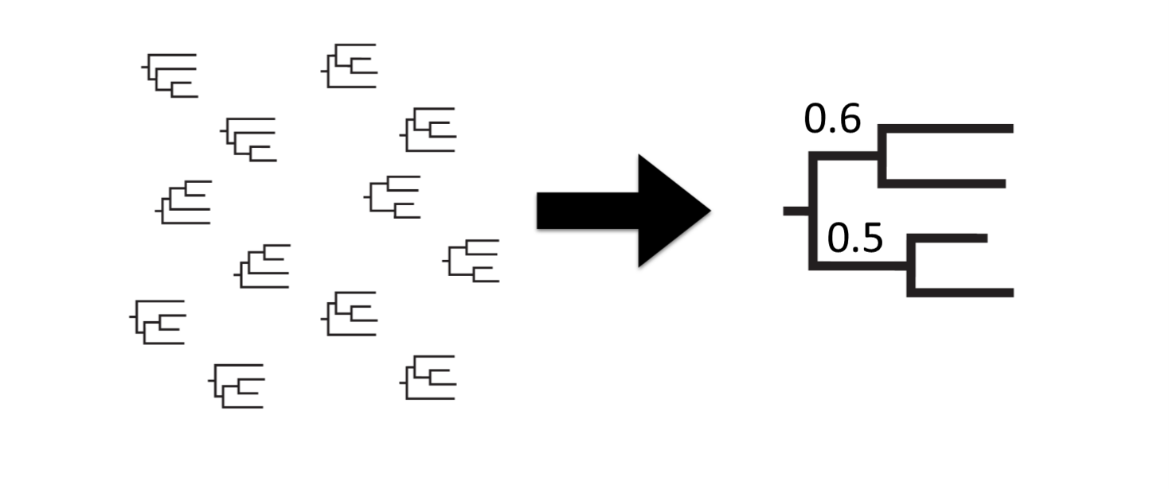
Summarizing Tree Sets
Tree Set
Majority Rule Consensus Tree
Loss Of Information!
T. Margush and F. R. McMorris, Consensus n-trees, B. Math. Biol. 43 (1981), no. 2, 239–244

Slide 74
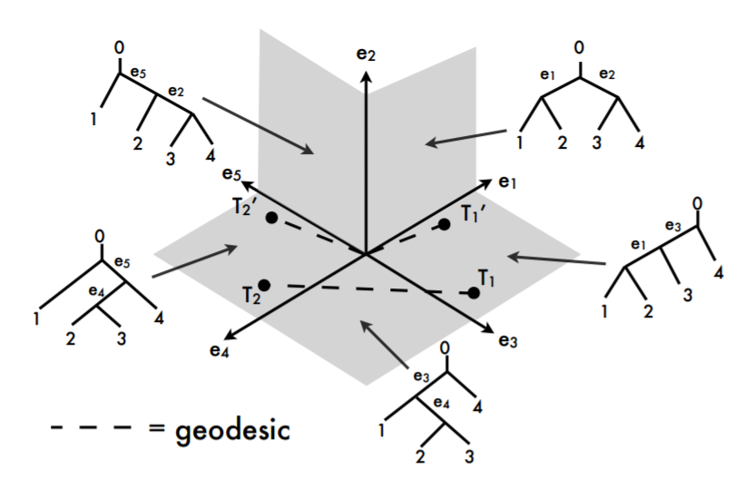
Megan Owen 2011

Slide 77
Method for Community Detection
Constant-Potts Model(CPM):
Notes:
Hamilitonian, , minimized by an optimization algorithm
is the community bipartition i belongs to
is zero unless =
is community size squared
Lambda values are tuning parameters
Only the difference matters in this case

Slide 78
Non Linear Dimensionality Reduction
Notes:
Global PCA methods fail on nonlinear manifolds, and local methods depend heavily on the precise choice of local regions and thresholds. The eigenvalue methods may be a good tool for exploratory data analysis, where one might plot the eigenvalues and look for a clear-cut boundary, but not for providing reliable estimates of intrinsic dimension.

